Slide 1
ToDo: value stream maps

Slide 2
'The Phoenix Project' & 'The Goal’
Lessons learned from
@LlewellynFalco

Slide 3
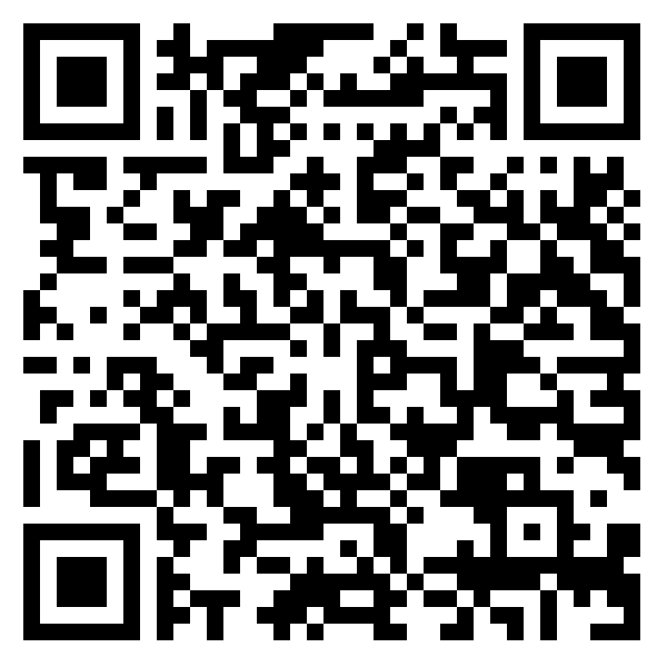
https://lfal.co/PhoenixGoal

Slide 4

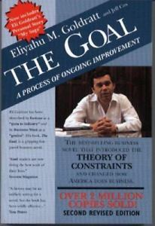
&
Bill, VP of IT Operations
Alex the plant manager

Slide 5

Promotion
TROUBLE
MENTOR
Start
Not enough
SALES
Success
Bill
Alex
Promotion
TROUBLE
MENTOR
Start
Not enough
SALES
Success

Slide 6
Success

Slide 7
“Movement is not Work ” - Taiichi Ohno

Slide 8
What the Goal got to do with me?

Slide 9
This IS me

Slide 10
Visualize the Work

Slide 11
Value Stream

Slide 12
Kanban

Slide 13
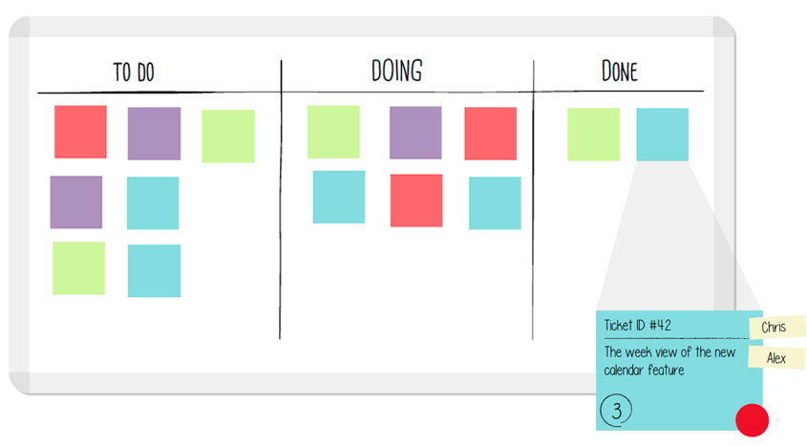
Kanban

Slide 14
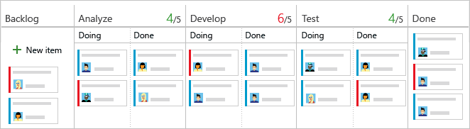

Slide 16
Optimize for Change in your visualization

Slide 17

What is Work?

Slide 18
BottleNeck

Slide 19






Chapter 13 – The Goal

Slide 23
Theory of constraints

Slide 24
Brent works for wes. He’s always in the middle of the important projects
that IT is working on. I’ve worked with him many times. He’s definitely
a smart guy but can be intimidating because of how much he
knows. What makes it worse is that he’s right most of the time
Brent

Slide 25
The Goal Money

Slide 26
Inventory
Throughput
Costs

Slide 27
Alex – “Robots increased productivity by 36% in one department”
Jonah – “Are plant inventories down?” : No
“Is employee expense less?” : No
“Shipping more product?”: No
Alex – “but we must keep robots running to maintain efficiencies”
Jonah – Then “Inventories must be sky high and orders must be late.”

Slide 28
any improvement
not made at the constraint is just an illusion

Slide 29
5 Focusing STEPS
IDENTIFY the system's constraint.
EXPLOIT the constraint.
SUBORDINATE everything else to the constraint.
ELEVATE the constraint.
PREVENT INERTIA from becoming the constraint!

Slide 30
LEAD Time
* https://www.inc.com/justin-bariso/elon-musk-takes-customer-complaint-on-twitter-from-idea-to-execution-in-6-days.html

Slide 31
FLOW
vs.
utilization

Slide 32
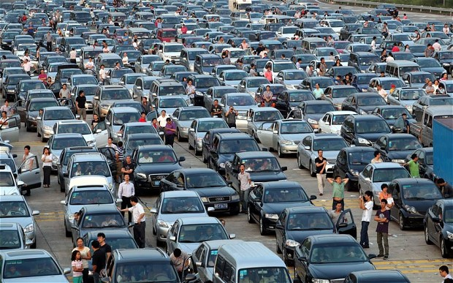
FLOW

Slide 33


Slide 34
The Goal
Alex’s First Chance to Test the Boy Scout Theory
Expectation:
Hourly Part Count
Fabrication
(25/hour)
Transfer
(once/hour)
Weld
(25/hour)
 | noon | 1:00 | 2:00 | 3:00 | 4:00
Fabrication | 25 | 25 | 25 | 25
Welding |  | 25 | 25 | 25 | 25

Slide 35
The Goal
Alex’s First Chance to Test the Boy Scout Theory
Realization:
100
90
Hourly Part Count
Fabrication
(25/hour)
Transfer
(once/hour)
Weld
(25/hour)
 | noon | 1:00 | 2:00 | 3:00 | 4:00
Fabrication | 19 | 21 | 28 | 32
Welding |  | 19 | 21 | 25 | 25

Slide 36
Sales
Notes:
Goal, still not good enough, get sales they were going to throw away because they couldn’t do it. 1000 pieces in 2 weeks -> 250 a week for 4 weeks.
$700 -> $600 because spare capacity

Slide 37
Random Bits
Notes:
Goal, still not good enough, get sales they were going to throw away because they couldn’t do it. 1000 pieces in 2 weeks -> 250 a week for 4 weeks.
$700 -> $600 because spare capacity

Slide 38
4 types of Work
Business
Internal
Operations
Unplanned

Slide 39
System Thinking
Feedback
Experimentation
3 ways

Slide 40
“INFOSEC WINS WHEN IT REMOVES WORK FROM IT”

Slide 41
MILITARY, Chemical Engineer, Auditors

Slide 42
“IMPROVING DAILY WORK IS EVEN MORE IMPORTANT THAN DOING DAILY WORK”

Slide 43
1.00^365 = 1 1.01^365 = 37.78

Slide 44
“Repetition creates habits, and habits are what creates mastery”

Slide 45

Contact Information
https://lfal.co/PhoenixGoal
@LlewellynFalco http://LlewellynFalco.Blogspot.com
http://www.approvaltests.com
Notes:
Both

